Slide 1
UDP CHAT APPLICATION

Slide 2
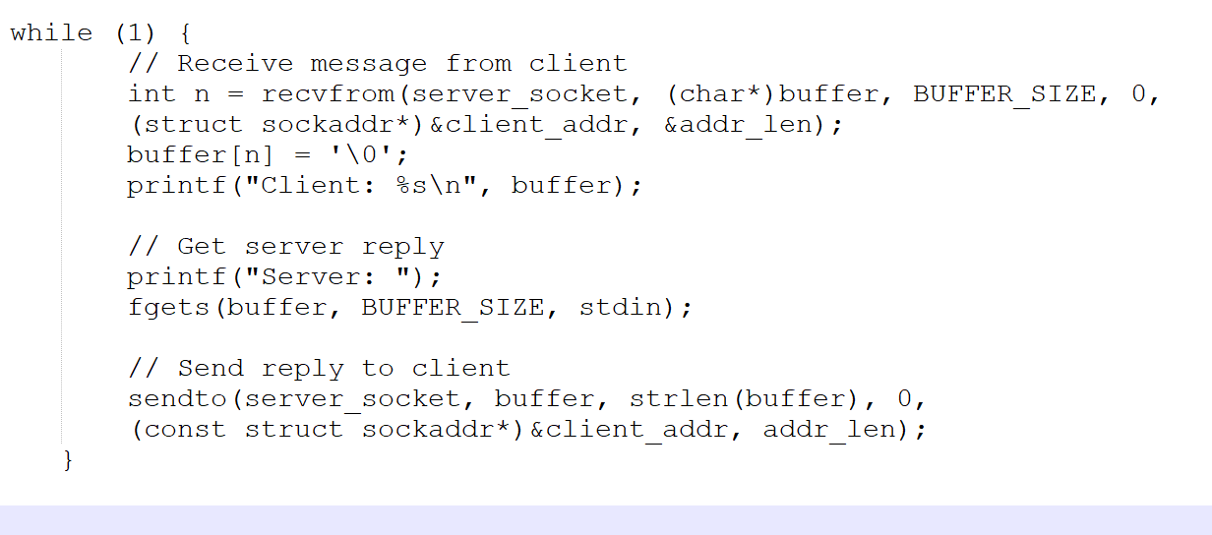
SERVER CODE

Slide 3
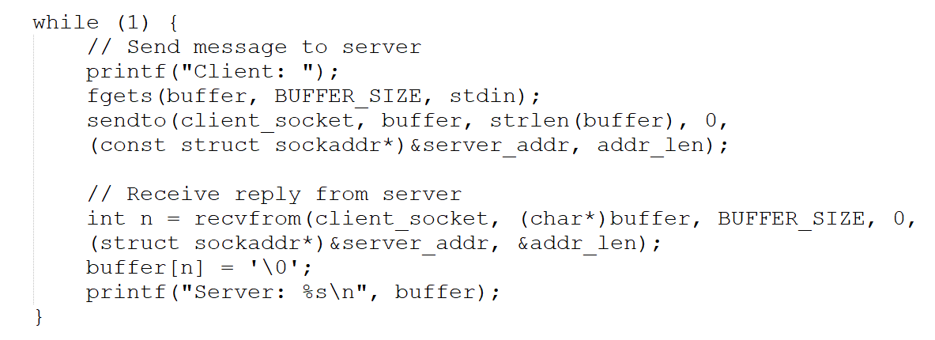
CLIENT CODE

